Slide 1
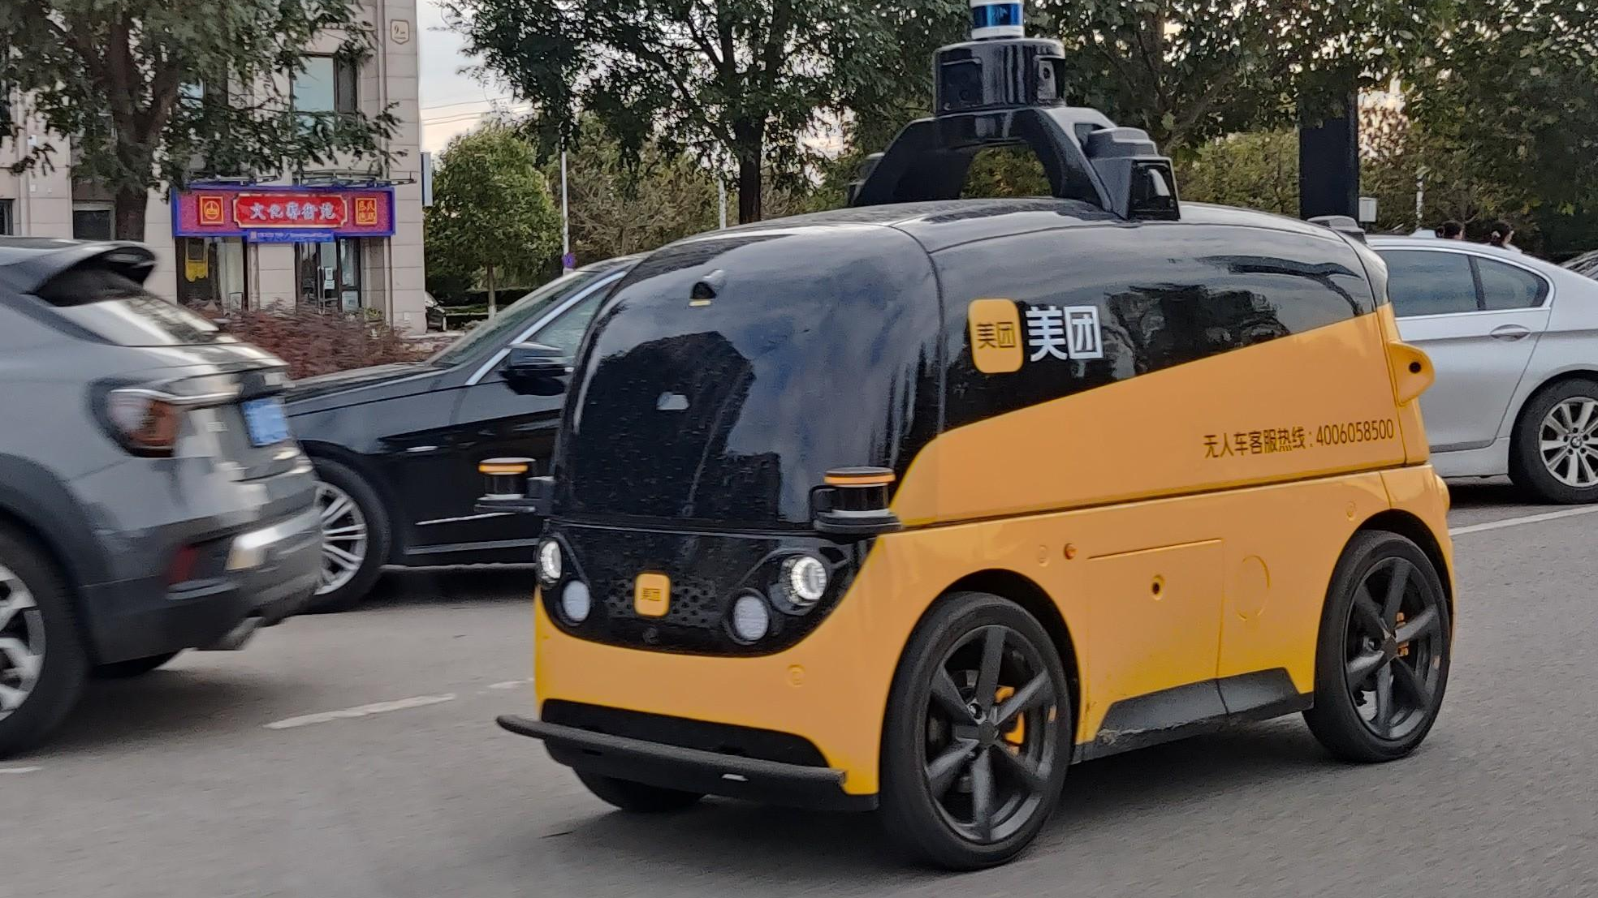
Autonomous Mobility: Last-Mile Delivery
Kaiqiang Zheng, Yujiong Chen
Notes:
https://en.m.wikipedia.org/wiki/File:Meituan_autonomous_delivery_vehicle_IMG003.jpg

Slide 2

Agenda
Introduction
Motivation behind Project
Challenges

Slide 3
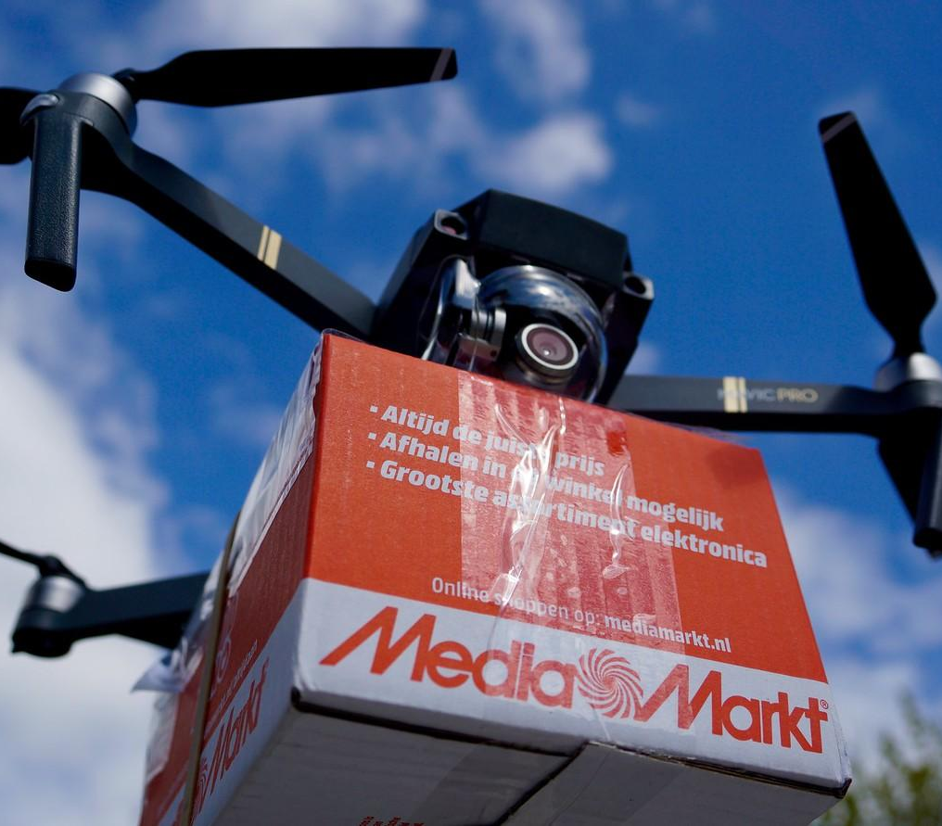
Introduction
In the face of rapid urbanization and the ever-expanding realm of e-commerce, the last mile of delivery has emerged as a critical bottleneck in the supply chain. Cities worldwide grapple with the challenges of delivery delays, escalating traffic congestion, safety concerns, and the pressing need to curb carbon emissions.
Recognizing the urgency of addressing these issues, our project aims to revolutionize urban logistics and enhance the sustainability of last-mile delivery services.
Notes:
https://www.flickr.com/photos/routeplanning/33751810990

Slide 4
Motivation Behind the Project
● Efficiency in Last Mile Delivery
● Environmental Sustainability
● Safety

Slide 5
Challenges
Traffic Congestion
CO2 Emissions
Safety Concerns

Slide 6
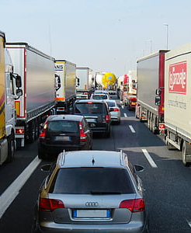
Traffic Congestion
Increased Delivery Delays
Higher Operational Costs
Reduced Customer Satisfaction
Notes:
https://www.pickpik.com/truck-highway-logistics-transport-of-goods-germany-speed-126666

Slide 7
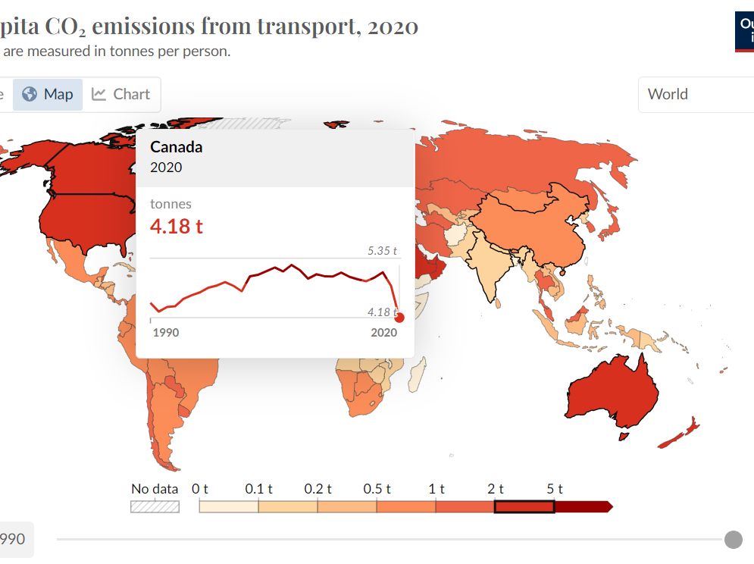

CO2 Emissions
Elevated CO2 emissions and air pollution due to vehicles idling in traffic.
Deterioration of air quality, leading to adverse health effects for residents.
Contradiction to sustainability goals, hindering efforts to create greener urban spaces.
Notes:
https://freesvg.org/car-emissions-vector-sign

Slide 8
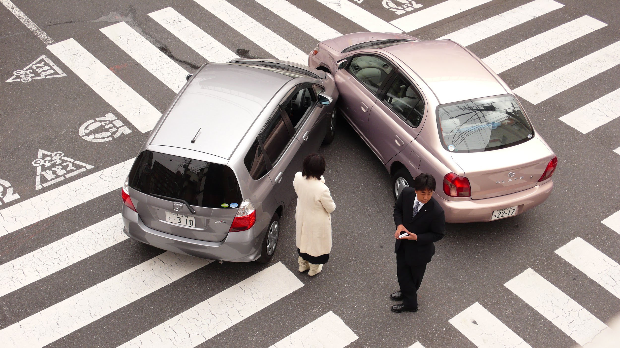
Safety Concerns
Higher likelihood of accidents and collisions in congested traffic conditions.
Risks to pedestrians and cyclists due to crowded roadways.
Emergency response times compromised, impacting the ability to address accidents promptly.
Notes:
https://en.wikipedia.org/wiki/Side_collision

Slide 12
Reference
[1]“Per capita CO₂ emissions from transport,” Our World in Data. https://ourworldindata.org/grapher/per-capita-co2-transport?stackMode=absolute%C2%AEion (accessed Nov. 19, 2023).
[2]“Death rate due to road traffic injuries,” Our World in Data. https://ourworldindata.org/grapher/death-rate-road-traffic-injuries?time=latest (accessed Nov. 19, 2023).
[3]koustubhk, “Worldwide Traffic Congestion Ranking,” Kaggle. https://www.kaggle.com/datasets/kkhandekar/worldwide-traffic-congestion-ranking/ (accessed Nov. 23, 2023).
[4]K. Zheng and Y. Chen, “Google Colaboratory,” McMaster4SC3, Nov. 22, 2023.https://colab.research.google.com/drive/1-SI2ISsVAEHRH-x7rWyxl6JuKe3KxRUg#scrollTo=TN4-SYlpuD9P (accessed Nov. 23, 2023).
[5]“Traffic Congestion in Lagos,” Internet Geography, Jan. 30, 2018. https://www.internetgeography.net/topics/traffic-congestion-in-lagos/#google_vignette (accessed Nov. 23, 2023).

